Slide 1
Interaction Design and Development I: Data Gathering and Analysis
CSIT226/CSIT826

Slide 2
Dr. Mark Freeman
School of Computing and Information Technology
Faculty of Engineering and Information Sciences

Slide 3
 | Topic | Reading
1 | Subject Overview and Introduction to HCI | Chapter 1
2 | User-Centred Design | Chapter 2
3 | User Interaction | Chapters 3 & 4
4 | User Interfaces | Chapters 5 & 6
5 | Information Presentation and Navigation | No Readings
6 | Accessibility and Special Issues in HCI | No Readings
7 | Interaction Design and Development I: Data Gathering and Analysis | Chapters 7 & 8
8 | Interaction Design and Development II: Requirements and Modelling | Chapters 9 & 10
9 | Interaction Design and Development III: Prototyping | Chapters 11 & 12
10 | No Classes: Public Holiday | No Readings
11 | Usability Evaluation Methods I | Chapter 13
12 | Usability Evaluation Methods II | Chapters 14 & 15
13 | Future HCI & Subject Revision | No Readings

Slide 4
This Week
Review of last week
Data Gathering
Analysis

Slide 5
Subject Description
The subject provides students with an understanding of Human Computer Interaction (HCI) principles and practices, and how to apply them in the context of developing usable interactive computer applications and systems. The subject also emphasises the importance of taking into account contextual, organisational, and social factors in the design of computer systems. Students will be taken through the analysis, design, development, and evaluation of user interfaces. They will acquire hands-on design skills through an interaction design project. The subject will cover topics including user-centred design, the development process, prototyping, usability testing, measuring and evaluating the user experience and accessibility.

Slide 6
Subject Learning Outcomes (SLOs)
On successful completion of this subject, students will be able to:
Identify and describe HCI principles and design issues.
Discuss and justify HCI solutions based on design principles.
Demonstrate an understanding of the HCI design process.
Acquire skills to design and implement user-centred design.
Select and use suitable methods of measuring and evaluating the user experience.

Slide 7
Disabilities affecting computer accessibility
Visual impairments
Blindness, low vision, colour blindness
Hearing disabilities
Speech impairments
Mobility impairments
Cognitive impairments
literacy

Slide 8
WCAG 2 at a Glance https://www.w3.org/WAI/WCAG20/glance/
Perceivable
Provide text alternatives for non-text content.
Provide captions and other alternatives for multimedia.
Create content that can be presented in different ways, including by assistive technologies, without losing meaning.
Make it easier for users to see and hear content.
Operable
Make all functionality available from a keyboard.
Give users enough time to read and use content.
Do not use content that causes seizures.
Help users navigate and find content.
Understandable
Make text readable and understandable.
Make content appear and operate in predictable ways.
Help users avoid and correct mistakes.
Robust
Maximize compatibility with current and future user tools.

Slide 9
Moving from theory to process…

Slide 10
You need to become a Problem Solver!
What data to gather
From WHO?

Slide 11
The Computing/Business Problem Solver
Has computer technology knowledge
Some programming expertise
Understands business problems
Uses logical methods for solving problems
Has fundamental curiosity
Wants to make things better

Slide 12
One Approach to Problem Solving
Who?
What?
Research and understand the problem
Verify benefits of solving problem outweigh the costs
What?
Define the requirements for solving the problem
Develop a set of possible solutions (alternatives)
How?
One
Decide which solution is best and recommend
Define the details of the chosen solution
Implement the solution
Monitor to ensure desired results

Slide 13

What is DESIGN? What are we DESIGNING?

Slide 14
“Design” - a verb & a noun
Problem solving
Applied creativity… solution focus
As learning… learn your way thru a problem
As evolution (iterative process)
As a social process
As a game
Heuristics, patterns, templates
Design both a THING & a WAY of USING IT

Slide 15
Consider…What features would you put in a smartphone?
Big Screen
Long battery life
Size
Big screen
Long battery life
Size
THE ART OF TRADEOFF

Slide 16
NEVER one single solution
If any algorithm could generate a perfect solution to multi-dimensional constraint satisfaction problem…
THEN…
There’d be NO engineers, architects or designers

Slide 17
So… What is “DESIGN”?
It is a series of TRADE-OFF’s
To SATISFY all of a project’s NEEDS (requirements)
AND
A maximal subset of WANTS
WITHIN a bunch of Constraints
Time
Money (construction, operation, maintenance)
Material
Personnel (stakeholders, users, staffs)
Legal (Regulation, standards, copyrights)
Technical
…

Slide 18
How to Fail in Design
Cling to your first idea
Jump into details too soon
Solve one aspect first
Ignore stakeholders
Design the product, then how to use it
“Surprise” your client with finished product
Wait, wait,… keep waiting… for inspiration
Not planning

Slide 19
Predictive vs. Adaptive
Predictive design
Assumes the system is well understood
Development project can be planned & organized in advance, then developed according to the plan
Adaptive design
Assumes the system requirements are “not well understood”
Some requirements may only emerge after some preliminary development work

Slide 20
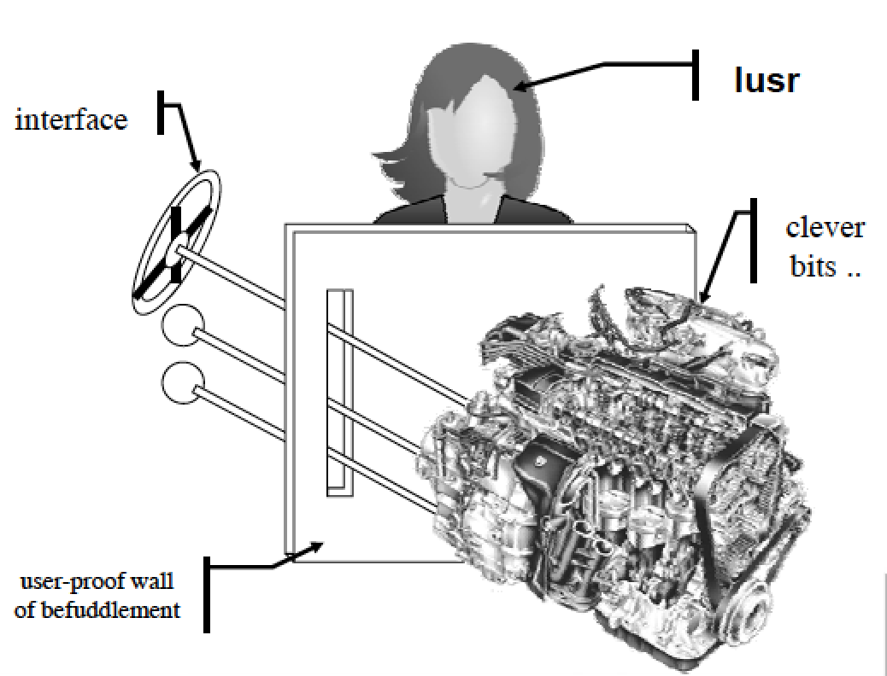
Use, User, Usability

Slide 21

Understanding Objectives in Design
SMART criteria are useful reminders on how to ensure that the project has created understandable and measurable objectives
Specific
Measurable
Agreed upon
Realistic
Time-framed
Notes:
If an objective is not specific then it is open to interpretation.
If an objective is not measurable then there is no way to determine whether the project is on track.
If an objective is not agreed upon then chances are high the project will fail.
If an objective is not realistic then chances are high that the project will fail.
If an objective does not include a time frame then there is no way to determine whether the project is on track.
Why is the following statement not SMART? I will work hard this semester to achieve my goals.
It does not state what the goals are.
It does not state how to measure ‘working hard’.
It might not be realistic, depending on the goals.
It does have a time frame of one semester.

Slide 22
Techniques
Business Documents
One-on-one Interviews
Group Interviews (focus groups)
Facilitated sessions
Joint Application Development
Questionnaires
Prototyping
Use cases
Shadowing / Observation
Brainstorming sessions
Requests for {information, proposals, tenders, quotation}

Slide 23
Business Documents – Fact Gathering
Observe and document business processes
Varies from office walkthroughs to performing actual tasks
Not necessary to observe all processes at same level of detail
NOTE: Can make employees/system users nervous, so use common sense
Document workflow with diagrams
UML Activity Diagrams
BPMN (Business Process Modelling Notation)

Slide 24
Chapter 7: Gathering Data AIMS
Discuss how to plan and run a successful data gathering program.
Enable you to plan and run an interview.
Enable you to design a simple questionnaire.
Enable you to plan and carry out an observation.

Slide 25
Five key issues
Setting goals
Decide how to analyze data once collected
Identifying participants
Decide who to gather data from
Relationship with participants
Clear and professional
Informed consent when appropriate
Triangulation
Look at data from more than one perspective
Collect more than one type of data, eg qualitative from experiments and qualitative from interviews
Pilot studies
Small trial of main study

Slide 26
Data recording
Notes, audio, video, photographs can be used individually or in combination:
Notes plus photographs
Audio plus photographs
Video
Different challenges and advantages with each combination
26

Slide 27
Interviews
Unstructured - are not directed by a script. Rich but not replicable.
Structured - are tightly scripted, often like a questionnaire. Replicable but may lack richness.
Semi-structured - guided by a script but interesting issues can be explored in more depth. Can provide a good balance between richness and replicability.
Focus groups – a group interview

Slide 28
Interview Questions
Two types:
‘closed questions’ have a predetermined answer format, e.g.. ‘yes’ or ‘no’, scale based
‘open questions’ do not have a predetermined format
Closed questions are easier to analyze
Avoid:
Long questions
Compound sentences - split them into two
Jargon and language that the interviewee may not understand
Leading questions that make assumptions e.g.. why do you like …?
Unconscious biases e.g.. gender stereotypes

Slide 29
Running the interview
Introduction – introduce yourself, explain the goals of the interview, reassure about the ethical issues, ask to record, present the informed consent form.
Warm-up – make first questions easy and non-threatening.
Main body – present questions in a logical order
A cool-off period – include a few easy questions to defuse tension at the end
Closure – thank interviewee, signal the end, e.g. switch recorder off.

Slide 30
Enriching the interview process
Props - devices for prompting interviewee, e.g. use a prototype, scenario

Slide 31
Advantages of Interviews
Opportunity for Feedback – Interviewer can provide direct feedback to the respondent, give clarifications and help alleviate any misconceptions or apprehensions over confidentiality that the respondent may have in answering the interviewer’s questions
Probing Complex Answers – Interviewers can probe if the respondent’s answer is too brief or unclear. This gives interviewers some flexibility in dealing with unstructured questions and is especially suited for handling complex questions
Length of Interview – If the questionnaire is very lengthy, the personal interview is the best technique for getting respondents to cooperate, without overtaxing their patience

Slide 32
Advantages of Interviews
Props & Visual Aids – Interviewers have the opportunity of showing respondents items such as sample products, graphs ands sketches, which can aid in their answers
High Participation – Interviewing respondents personally can increase the likelihood of their participation, as many people prefer to communicate directly verbally and sharing information and insights with interviewers

Slide 33
Disadvantages of Interviews
Cost – Personal interviews are usually more expensive than mail, telephone and internet surveys. Factors influencing the cost of the interview include the respondents’ geographic proximity, the length and complexity of the questionnaire, and the number of non-respondents
Lack of Anonymity – Respondents are not anonymous in a personal (face-to-face) interview and may be reluctant to disclose certain information to the interviewer. Hence, considerable must be expended by the interviewer when dealing with sensitive questions to avoid bias effects on the respondent’s part
Necessity for Callbacks – When a person selected for interview cannot be reached the first time, a callback has to be scheduled which result in extra cost and time spent

Slide 34
Disadvantages of Interviews
Variance Effects – It has been shown that the demographic characteristics of the interviewer can influence the answers of the respondents. In one study, male interviewers had a much larger variance of answers than female interviewers in a sample of most female individuals
Dishonesty – Interviewers cheat to make their life easier and save time and effort
Personal Style – The interviewers individual questioning style, techniques, approach and demeanor may influence the respondents’ answers
Global Considerations – Cultural aspects may influence peoples’ willingness to participate in an interview (e.g. repressive Middle Eastern cultures discourage females from being questioned by male interviewers)

Slide 35
Enhancing Interviews
Tell me more…
Why?
silence

Slide 36
Joint Application Development
Can speed up the process of data gathering
Decision makers present
Users, technical staff, project members all together for determining:
Current processes (facts)
Requirements definition
Model development
Policy decisions
Etc.

Slide 37
Questionnaires
Questions can be closed or open
Closed questions are easier to analyze, and may be distributed and analyzed by computer
Can be administered to large populations
Disseminated by paper, email and the web
Sampling can be a problem when the size of a population is unknown as is common online evaluation
Online Questionnaires (many systems available)
SurveyMonkey
Google Forms
Qualtrics

Slide 38
Advantages of online questionnaires
Relatively easy and quick to distribute
Responses are usually received quickly
No copying and postage costs
Data can be collected in database for analysis
Time required for data analysis is reduced
Errors can be corrected easily
38

Slide 39
Questionnaire design
The impact of a question can be influenced by question order.
You may need different versions of the questionnaire for different populations.
Provide clear instructions on how to complete the questionnaire.
Strike a balance between using white space and keeping the questionnaire compact.
Avoid very long questionnaires
Decide on whether phrases will all be positive, all negative or mixed.

Slide 40
Question and response format
‘Yes’ and ‘No’ checkboxes
Checkboxes that offer many options
Rating scales
Likert scales
semantic scales
3, 5, 7 or more points
Open-ended responses
40

Slide 41
Encouraging a good response
Make sure purpose of study is clear
Promise anonymity
Ensure questionnaire is well designed
Offer a short version for those who do not have time to complete a long questionnaire
If mailed, include a stamped addressed envelope
Follow-up with emails, phone calls, letters
Provide an incentive
40% response rate is good, 20% is often acceptable

Slide 42
Observation
Direct observation in the field
Structuring frameworks
Degree of participation (insider or outsider)
Ethnography
Direct observation in controlled environments
Indirect observation: tracking users’ activities
Diaries
Interaction logging
Video and photographs collected remotely by drones or other equipment
42
Notes:
Figure 7.9 Mars Exploration Rover p257
Please add source: Source: Reproduced by permission of NASA Jet Propulsion Laboratory (NASA-JPL).

Slide 43
Structuring frameworks to guide observation
Three easy-to-remember parts:
The person: Who?
The place: Where?
The thing: What?
A more detailed framework (Robson, 2014):
Space: What is the physical space like and how is it laid out?
Actors: What are the names and relevant details of the people involved?
Activities: What are the actors doing and why?
Objects: What physical objects are present, such as furniture
Acts: What are specifi c individual actions?
Events: Is what you observe part of a special event?
Time: What is the sequence of events?
Goals: What are the actors trying to accomplish?
Feelings: What is the mood of the group and of individuals?

Slide 44
Planning and conducting observation in the field
Decide on how involved you will be: passive observer to active participant
How to gain acceptance
How to handle sensitive topics, e.g. culture, private spaces, etc.
How to collect the data:
What data to collect
What equipment to use
When to stop observing

Slide 45
Ethnography
Ethnography is a philosophy with a set of techniques that include participant observation and interviews
Debate about differences between participant observation and ethnography
Ethnographers immerse themselves in the culture that they study
A researcher’s degree of participation can vary along a scale from ‘outside’ to ‘inside’
Analyzing video and data logs
Collections of comments, incidents, and artifacts are made
Co-operation of people being observed is required
Informants are useful
Data analysis is continuous
Interpretivist technique
Questions get refined as understanding grows
Reports usually contain examples

Slide 46
Observations and materials that might be collected (Crabtree, 2007)
Activity or job descriptions
Rules and procedures that govern particular activities
Descriptions of activities observed
Recordings of the talk taking place between parties
Informal interviews with participants explaining the detail of observed activities
Diagrams of the physical layout, including the position of artifacts
Other information collected when observing activities:
Photographs of artifacts (documents, diagrams, forms, computers, etc.)
Videos of artifacts
Descriptions of artifacts
Workflow diagrams showing the sequential order of tasks
Process maps showing connections between activities
46

Slide 47
Observation in a controlled environment
Direct observation
Think aloud techniques
Indirect observation – tracking users’ activities
Diaries
Interaction logs
Web analytics
Video, audio, photos, notes are used to capture data in both types of observations
47

Slide 48
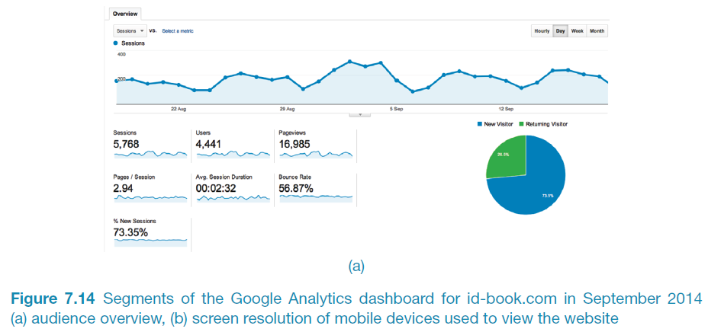
A section of Google analytics dashboard for id-book.com
48

Slide 49
Request for …
Information
Proposals
Insufficient understanding of the problem
Tenders
Looking for a solution to meet a business problem
Quotation
Clearly defined specifications and selection criteria
Decision based primarily on price
Further information before decision
Screening tool for understanding the market
Decision based on price and qualitative factors

Slide 50
Choosing and combining techniques
Depends on the:
Focus of the study
Participants involved
Nature of the technique(s)
Resources available
Time available
50

Slide 51
Chapter 8: Data Analysis, Interpretation and Presentation AIMS
Discuss the difference between qualitative and quantitative data and analysis.
Enable you to analyze data gathered from:
Questionnaires.
Interviews.
Observation studies.
Make you aware of software packages that are available to help your analysis.
Identify common pitfalls in data analysis, interpretation, and presentation.
Enable you to interpret and present your findings in appropriate ways.
www.id-book.com

Slide 52
Quantitative and qualitative
Quantitative data – expressed as numbers
Qualitative data – difficult to measure sensibly as numbers, e.g. count number of words to measure dissatisfaction
Quantitative analysis – numerical methods to ascertain size, magnitude, amount
Qualitative analysis – expresses the nature of elements and is represented as themes, patterns, stories
Be careful how you manipulate data and numbers!
www.id-book.com

Slide 53
Simple quantitative analysis
Averages
Mean: add up values and divide by number of data points
Median: middle value of data when ranked
Mode: figure that appears most often in the data
Percentages
Be careful not to mislead with numbers!
Graphical representations give overview of data
www.id-book.com

Slide 54
Simple qualitative analysis
Recurring patterns or themes
Emergent from data, dependent on observation framework if used
Categorizing data
Categorization scheme may be emergent or pre-specified
Looking for critical incidents
Helps to focus in on key events
www.id-book.com

Slide 55
Tools to Support Data Analysis
Spreadsheet – simple to use, basic graphs
Statistical packages, e.g. SPSS, R
Qualitative data analysis tools
Categorization and theme-based analysis
Quantitative analysis of text-based data
Nvivo and Atlas.ti support qualitative data analysis
www.id-book.com

Slide 56
Theoretical frameworks for qualitative analysis
Basing data analysis around theoretical frameworks provides further insight
Three such frameworks are:
Grounded Theory – coding data and forming theory
Open: identify categories
Axial: flesh out and link to subcategories
Selective: form theoretical scheme
Distributed Cognition
Activity Theory
www.id-book.com

Slide 57
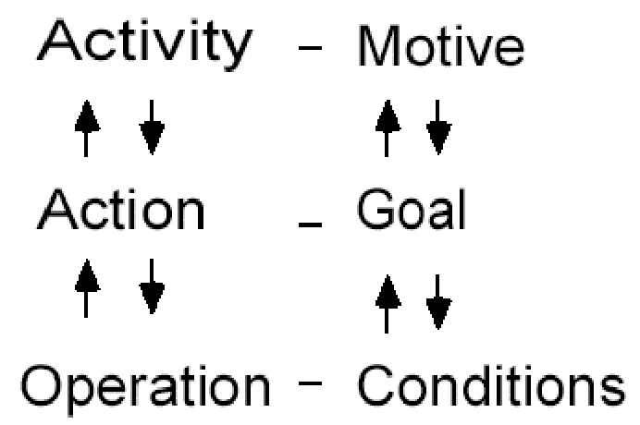
Individual model
www.id-book.com
16

Slide 58
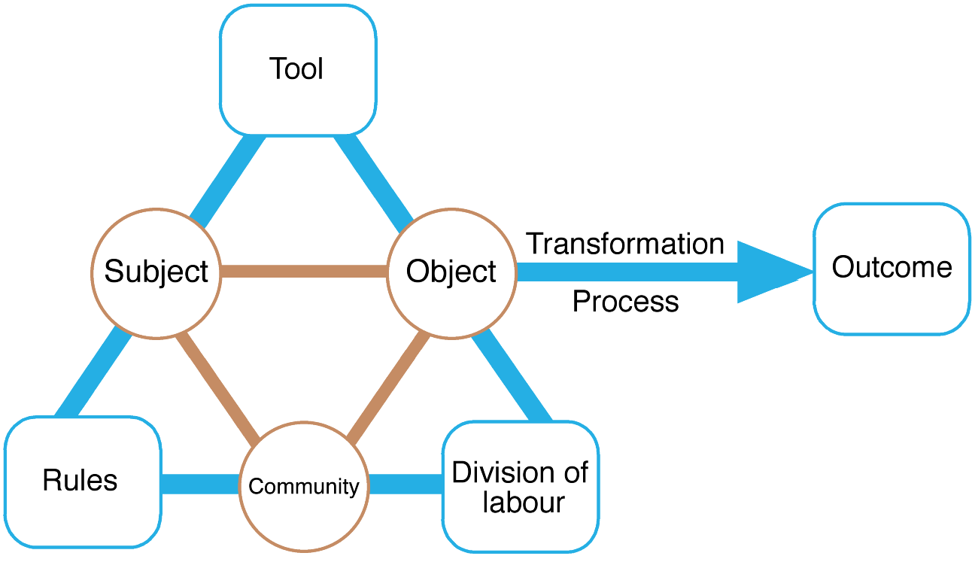
Engeström’s (1999) activity system model
www.id-book.com
17
Notes:
P312
Figure 8.17 Engeström’s (1999) activity system model. The tool element is sometimes referred to
as the mediating artifact
Source: Reproduced from Engeström, Y. (1999) Perspectives on Activity Theory, CUP.

Slide 59
Presenting the Findings
Only make claims that your data can support
The best way to present your findings depends on the audience, the purpose, and the data gathering and analysis undertaken
Graphical representations can be appropriate for presentation
Other techniques are:
Rigorous notations, e.g. UML
Persona Development
Using stories, e.g. to create scenarios
Summarizing the findings
What needs to be changed in the system – CRUD (Create, Read, Update, Delete)
www.id-book.com

Slide 60
Use Case Description
Use Case Name:
Scenario:
Triggering Event:
Brief Description:
Actors:
Related Use Cases:
Stakeholders:
Pre-conditions:
Post-conditions:
Flow of Activities: | Actor | System
Exceptions:

Slide 61
User Story
Less structure than a ‘use case’
A User Story is a one-sentence description of a work-related task done by a user to achieve some goal or result
Acceptance Criteria identify the features that must be present at the completion of the task
The template for a user story description is:
“As a <role> I want to <goal> so that <benefit>”

Slide 62
FRUPS+
Functionality
Usability
Reliability
Performance
Security
+
Constrains, standards, physical, other systems, etc.

Slide 63
Questions

